Slide 1
INSIGHTS AND INFERENCE FROM US ACCIDENT DATASET Gargeyi Baipa, Michael Lupo, Naveen Donthineni, Sreejit Sivasankaran, Vidhi Shah
Group 3
Notes:
Mike

Slide 2
Abstract
Road accident leads to more than 38,000 deaths every year in crashes on U.S. roadways and an additional 4.4 million injured seriously enough to require medical attention. Economic and societal impact of road crashes costs U.S. approximately $871 billion/year[7].
This project examines accidents occurring across US, over a 4 year period, through a detailed study of features associated with each. Our group followed a multi-phased approach to identify key factors linked to the accidents, both at an overall Country level and within one key State. The goal of the project is to outline key parameters causing accidents within a State as well as to propose potential accident mitigation strategies to policy makers and authorized personnel of respective departments (DoT, DMV etc.).
Notes:
https://www.asirt.org/safe-travel/road-safety-facts

Slide 3




Project analysis slide 3
About the Dataset
TIME FRAME
SCOPE OF DATA
RECORDED BY
DATA DIMENSIONS
CONNECTED DATA
Traffic accidents from February 2016 to December 2019.
Data contains accident information from 49 states of USA, sourced from Kaggle.com.
US and departments of transportation across States, law enforcement agencies, traffic cameras, and traffic sensors within the road-networks.
3 million records with 49 variables.
Connecting data from FHWA to include the vehicle population.
Colors in this slide are for graphical purpose only.
Notes:
FHWA – Federal highway administration. https://www.fhwa.dot.gov/policyinformation/statistics.cfm

Slide 4
Project analysis slide 4
Project Objective and Approach
Data cleansing
Exploratory Data Analysis
Project Objectives
Project Objectives
Implementation Plan
Deep-dive analysis
Customer Objectives
Highlight leading factors for Accidents
Findings and Conclusions

Slide 5






Project analysis slide 2
Data Cleansing
PRESSURE, WINDCHILL & TEMPERATURE
END LATITUDE & END LONGITUDE
NA with Mean values
Variables dropped
3 Million rows 49 columns
INFRASTRUCTURE VARIABLES
HOUR, MONTH & WEEKDAY
New measures calculated field
New columns created
ZIPCODE
CITY, ZIPCODE AND TIMEZONE
New dimension in Tableau
Blanks replace by Max value in State
Colors in this slide are for graphical purpose only.

Slide 6
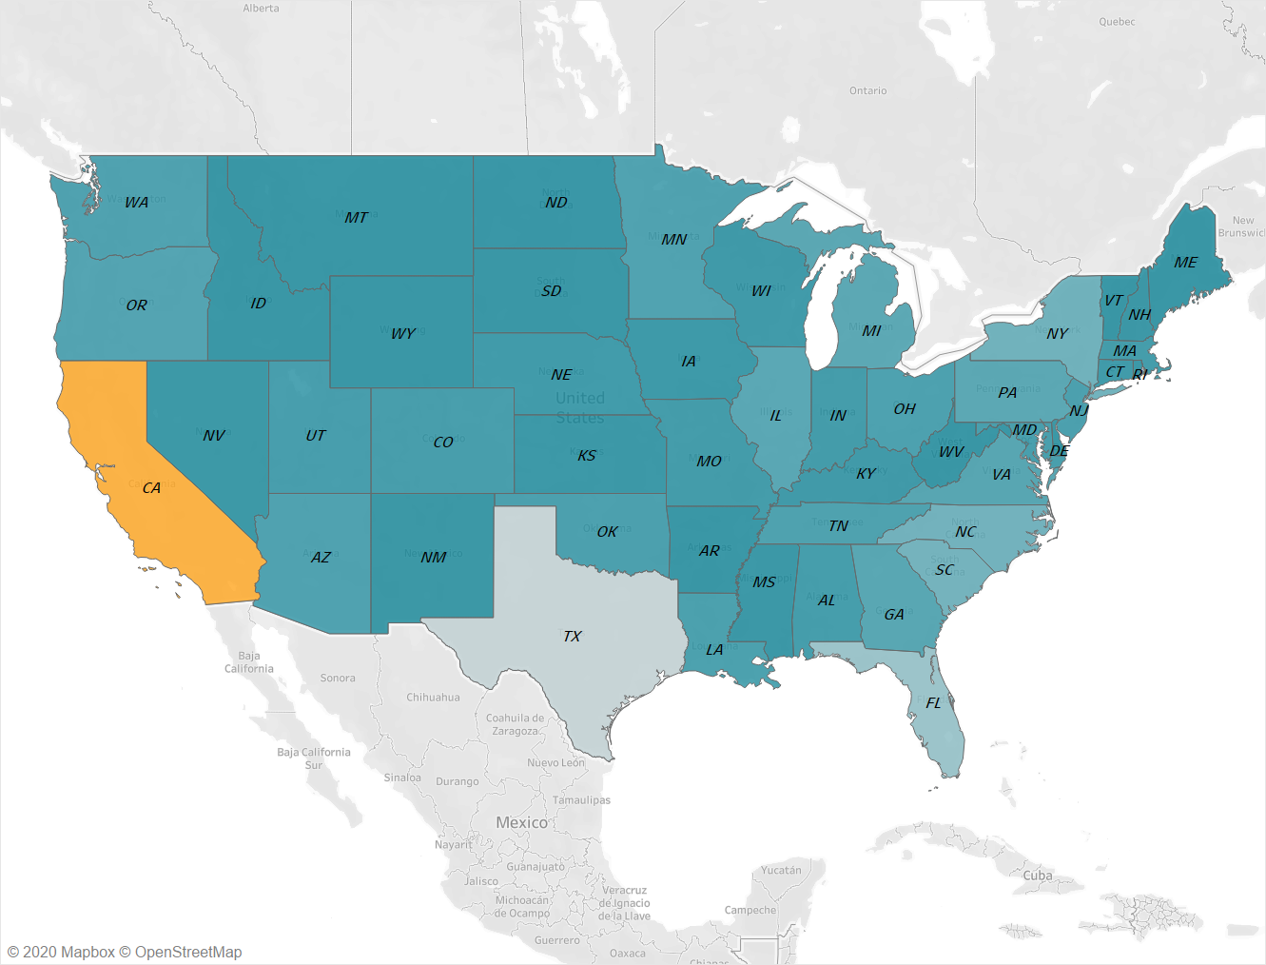
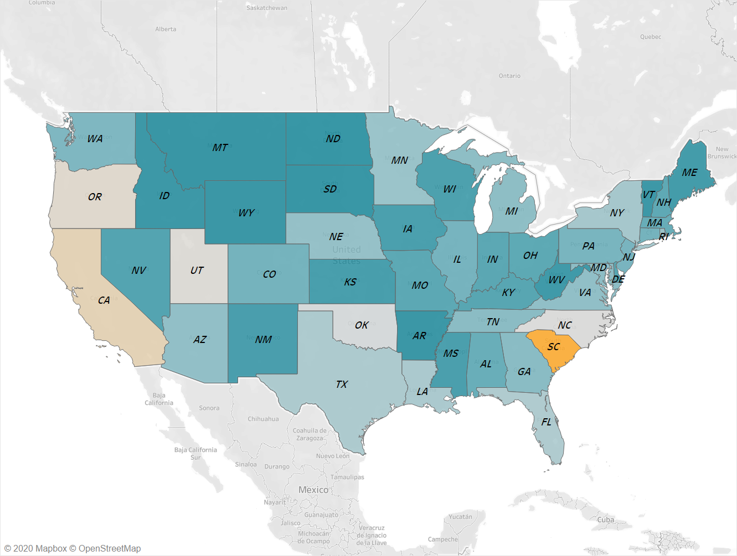
Project analysis slide 5
Which state has Maximum Accidents?
Initial findings
Average accidents per capita
663,204
0.68%
accidents have taken place in California,
followed by Texas and Florida.
is the accident rate in South Carolina followed by California at 0.44%
Period of reference from February 2016 to December 2019

Slide 7
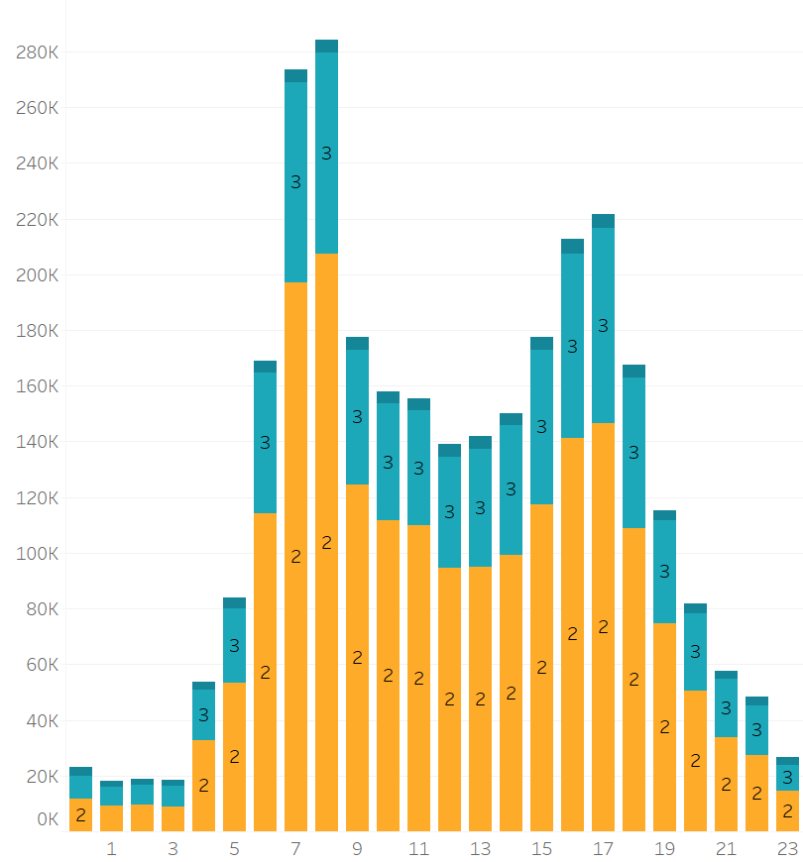


Project analysis slide 5
How severe are the accidents over the course of the day?
Most of the accidents are Severity 2.
Number of Accidents
Majority of accidents are during peak hours.
Hour of the day
Period of reference from February 2016 to December 2019; With severity 1 being minimal impact on traffic and 4 being highest impact.

Slide 8
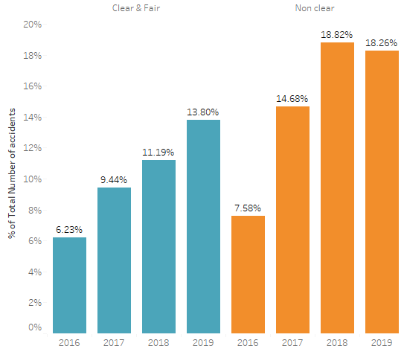
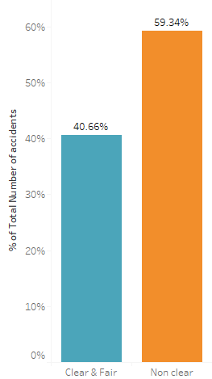
Project analysis slide 5
How does weather condition impact accidents
Initial findings
Over the years
60%
3%
of the accidents occur during non clear weather conditions.
of increase in accidents is seen approximately.
Period of reference from February 2016 to December 2019; across 49 states of USA.
Notes:
https://www.statista.com/statistics/183505/number-of-vehicles-in-the-united-states-since-1990/ (Rate of increase in Automobile in USA)

Slide 9
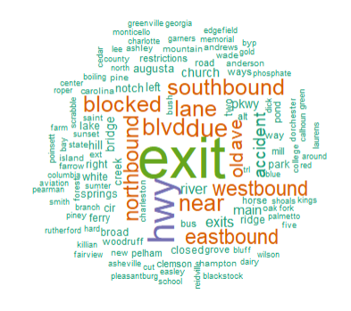
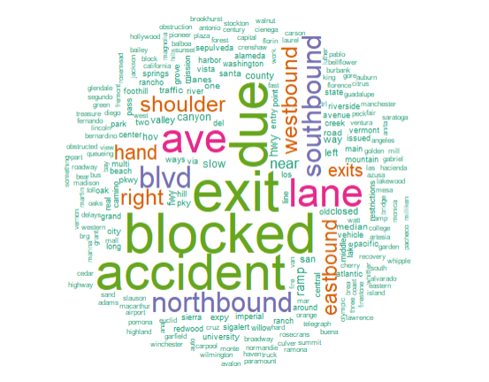


Project analysis slide 5
Text Analytics
South Carolina
California
“Exit” and “Highway” are the top words appearing in the description of accidents in South Carolina
Exit remains a common area of accidents in both state. The word blocked does suggest of traffic congestion.
“Exit”, “blocked” and “ave” are the top words appearing in the description of accidents in California[7]
Notes:
Text analytics was performed using R. Cleaned the data set.

Slide 10
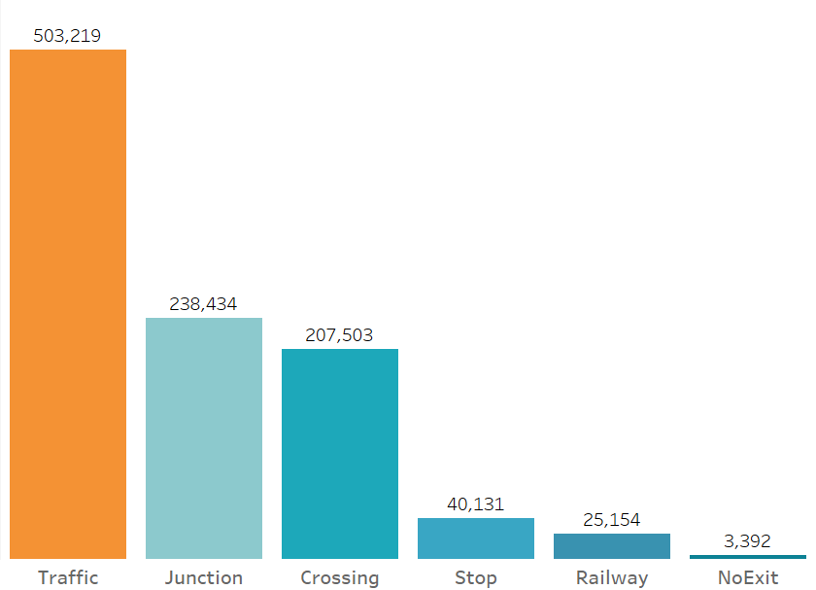
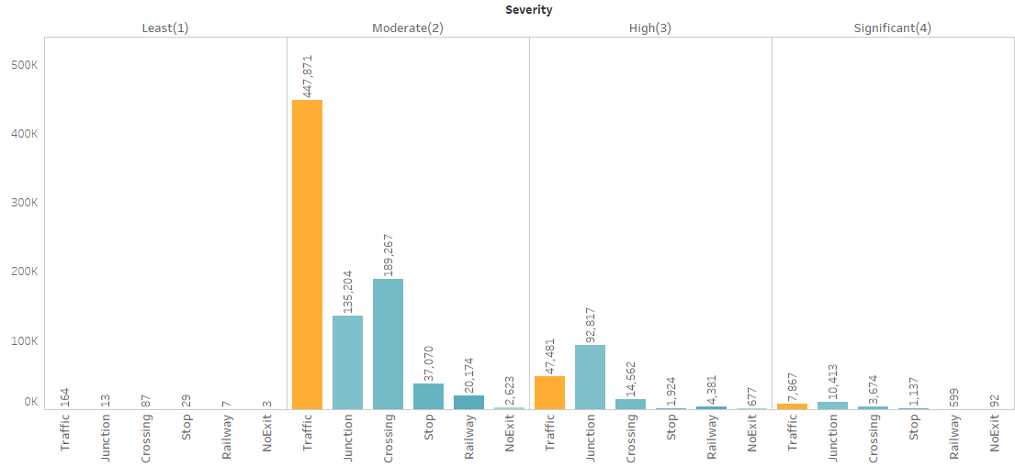
Project analysis slide 5
How do infrastructure variables impact accidents?
Number of Accidents
Traffic lights are the prime areas.
Traffic light remains to be top factor followed
by crossing for severity type 2 accidents.
Period of reference from February 2016 to December 2019; With severity 1 being minimal impact on traffic and 4 being highest impact.

Slide 11
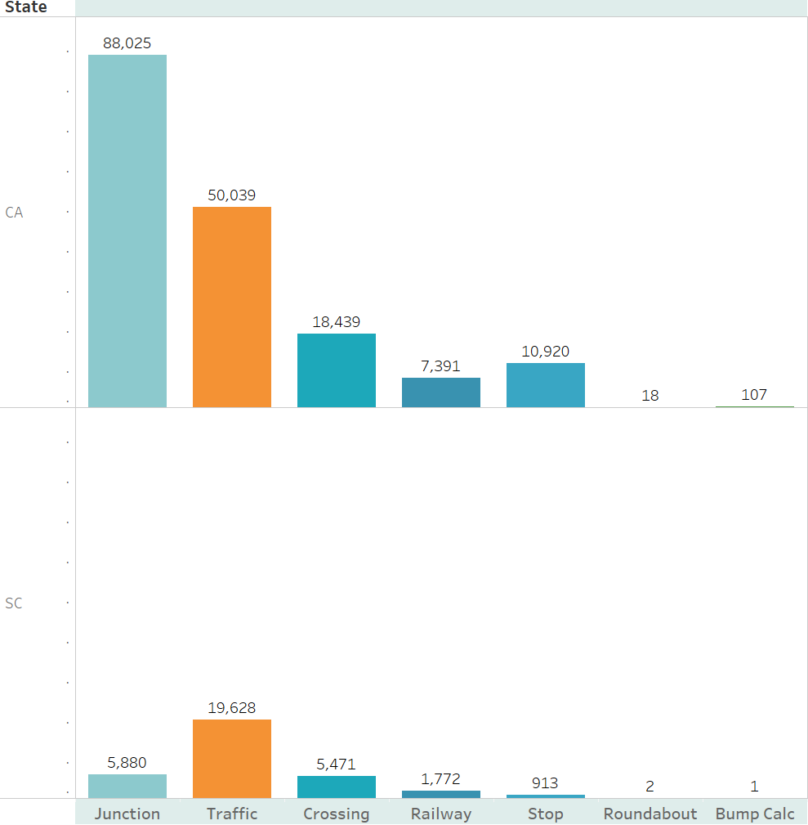
Project analysis slide 5
Which Infrastructure is major cause of accidents in California vs South Carolina?
Most of the accidents in California are seen at traffic junctions.
Number of Accidents
Whereas, maximum accidents in South Carolina are seen at traffic lights.
Deep-dive into South Carolina.

Slide 12

Project analysis slide 5
Findings using Machine Learning techniques Linear Regression and Lasso
Pressure
Visibility
Weather
Humidity
Precipitation
Temperature
Windchill
Stop
Crossing
Infrastructure
Traffic Signal l
Roundabout
Junction
Bump
Colors in this slide are for graphical purpose only.
Notes:
Explain our progress with story based on this finding

Slide 13
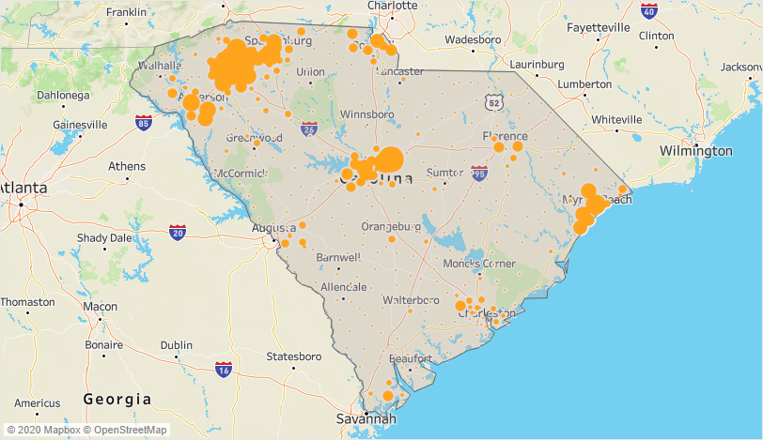
Which are the accident hotspots in South Carolina?
We see a cluster of accidents in 3 specific areas in South Carolina.
Greenville county with highest number of accidents will be analyzed.

Slide 14
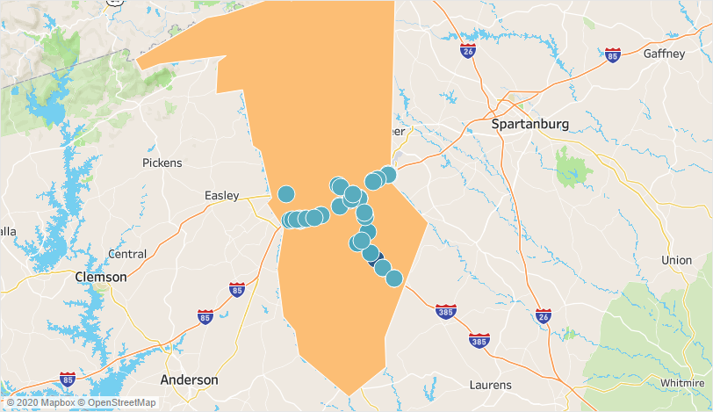
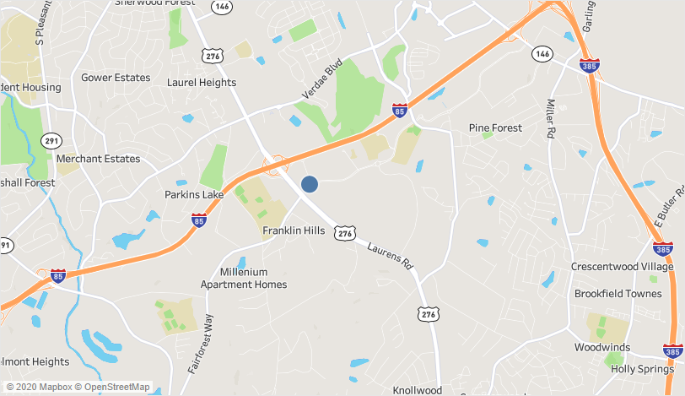
Which are the accident prone junctions in Greenville?
Most number of accidents on the junction of Laurens road and I85.

Slide 15
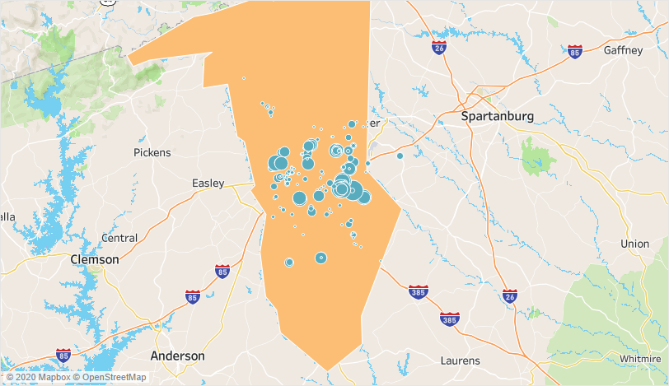
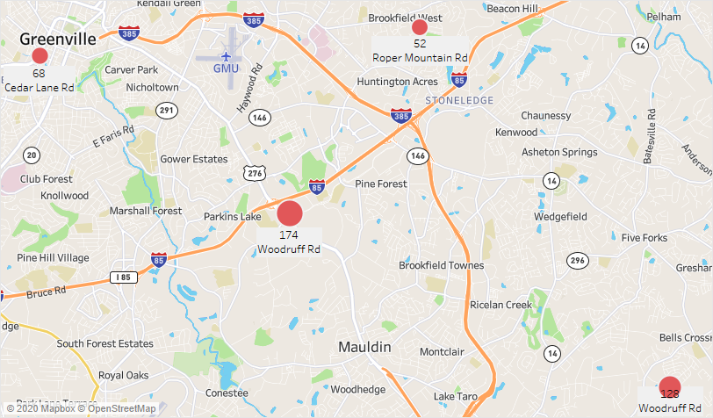
Which are the accident prone crossings in Greenville?
Most number of accidents on the Crossing are seen on Woodruff road and Millenium road.

Slide 16
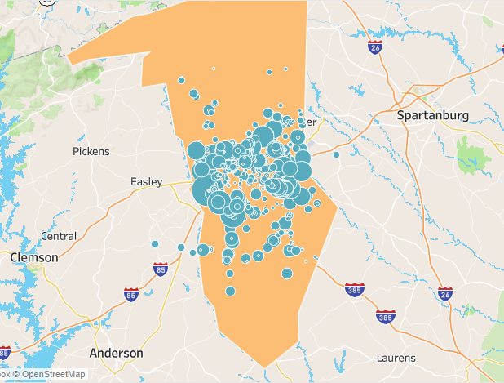
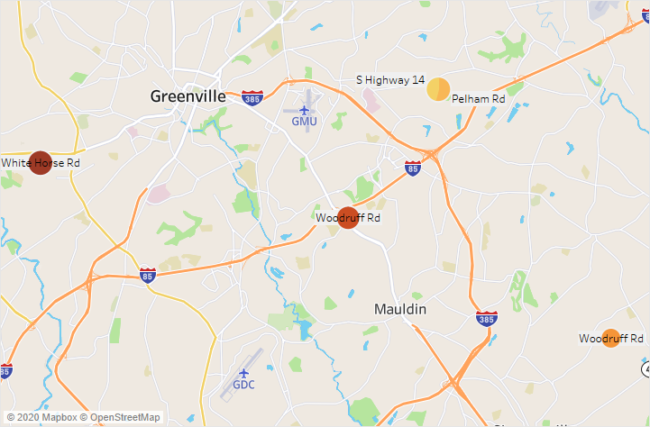
Which are the accident prone traffic light spots in Greenville?
Most number of accidents on the traffic light are seen on White Horse and Easely road.

Slide 17
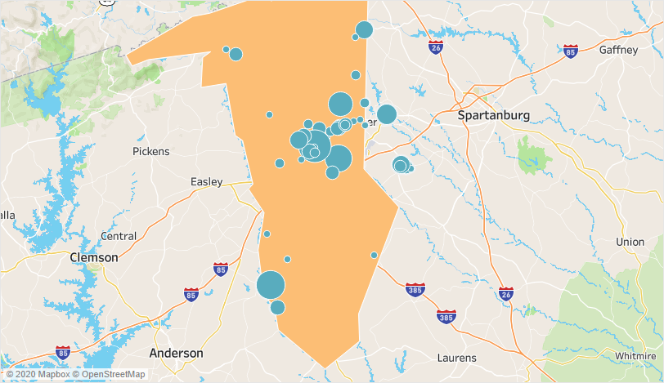
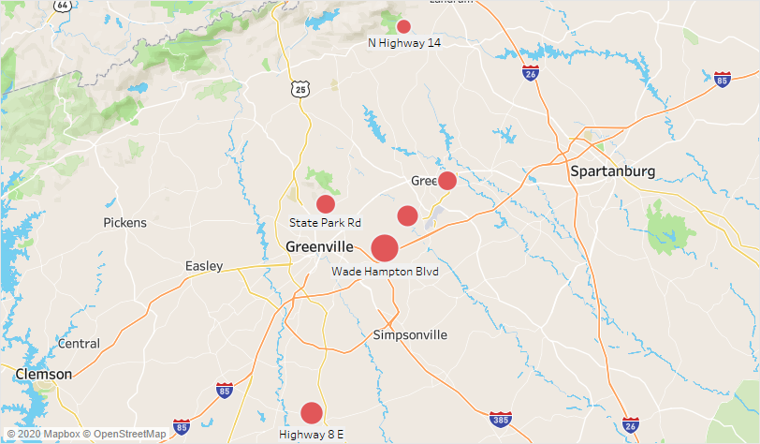
Which are the accident prone stop sign spots in Greenville?
Most number of accidents on the Stop signs are seen on Wade Hampton and Artillery road.

Slide 18





Project analysis slide 6
Key Findings and Conclusions
The rate of accident is more on non-clear weather days.
Infrastructure variables causing accidents varied across different states.
Most accidents were witnessed at 11am and 4 pm in the hotspots at SC which is in contrast with overall USA [1][2].
A study of similar populous state Maryland showed much fewer accidents as compared to South Carolina.
Maximum accidents occur on the right side (slow lanes) of the road.[5]
Hotspots locations varied between day and night in Greenville county.[3][4]
Colors in this slide are for graphical purpose only.
Notes:
Please refer to the Appendix slides.

Slide 19
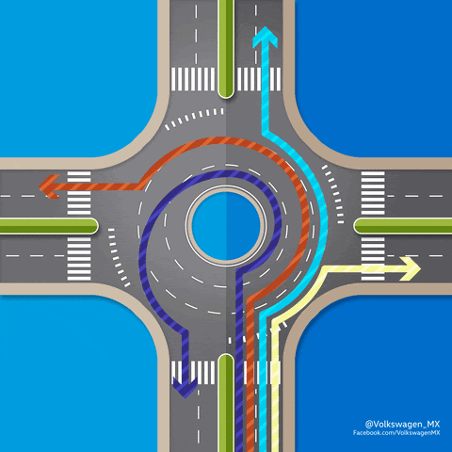
Recommendations
Replace traffic lights and intersections with roundabouts.
Resulting into 75% reduction in accidents.
Notes:
https://www.wsdot.wa.gov/Safety/roundabouts/benefits.htm

Slide 20
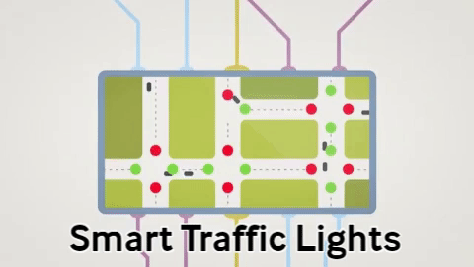
Recommendations
Replace traffic lights with smart traffic lights.
Notes:
http://www.mdot.maryland.gov/News/Releases2017/2017_Oct_25_Gov_Hogan_Introduces_Smart_Signals

Slide 21
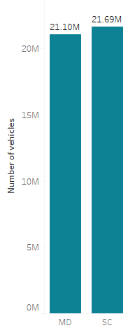
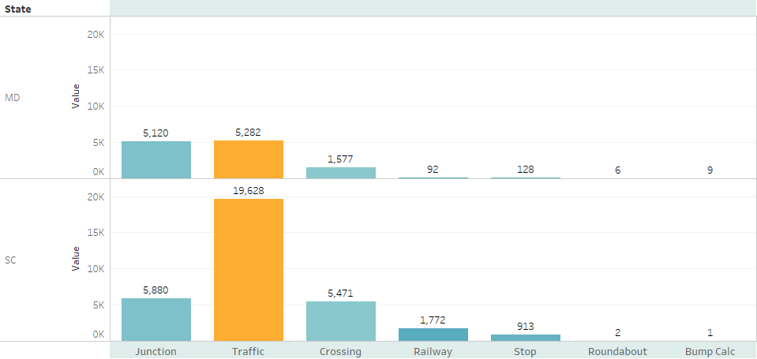
Basis for recommendation
Number of Accidents
A similar state as South Carolina, Maryland has least accidents with most roundabouts.
A secondary research suggests roundabouts are effective in reducing 75% of the accidents (1)
Smart lights have resulted in 25% reduction in travel time (2)
Notes:
https://today.umd.edu/articles/smart-signals-safer-intersections-fb11070a-8cf3-42a4-9f96-1c78cab9c51c
https://time.com/3845445/commuting-times-adaptive-traffic-lights/
https://www.rapidflowtech.com/surtrac/benefits

Slide 22
Thank You for listening to us!

Slide 23
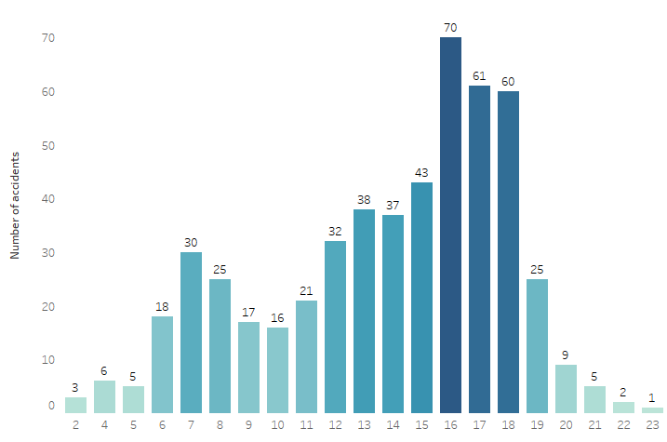
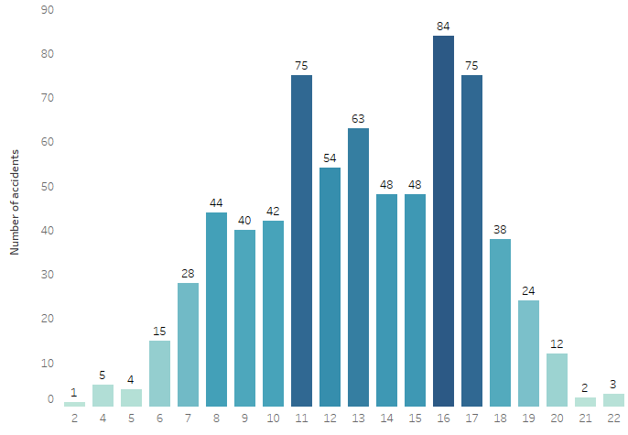
Project analysis slide 6
Appendix
1. Accidents during the course of day at Crossings in Greenville.
2. Accidents during the course of day on Junctions in Greenville.
Notes:
Appendix

Slide 24
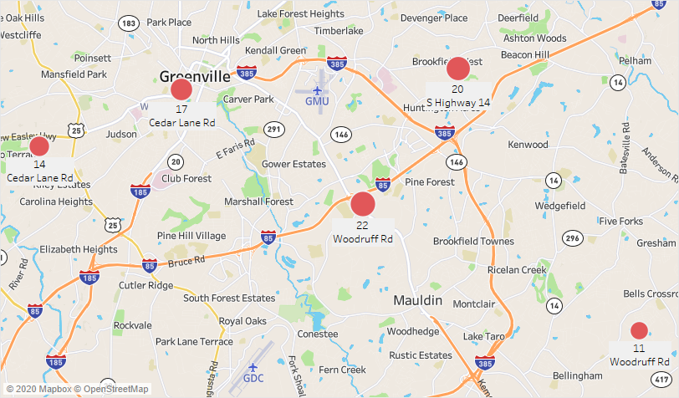
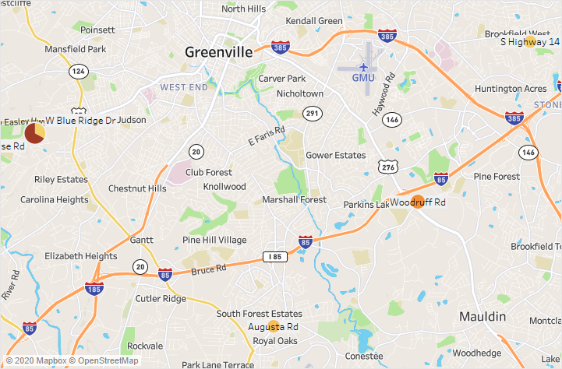
Project analysis slide 6
Appendix
3. Accidents during night at Crossings in Greenville.
4. Accidents during night at Traffic lights in Greenville.
Notes:
Appendix

Slide 25
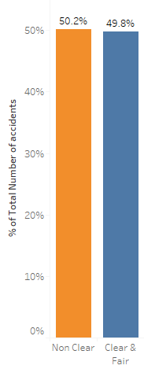
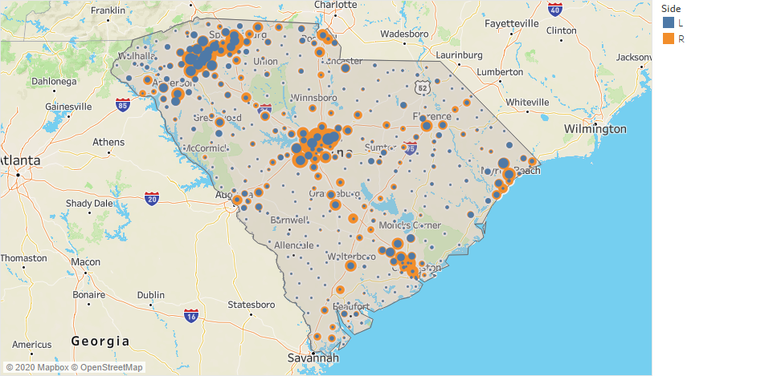
Project analysis slide 6
Appendix
5. Accidents classified by the side of the road in South Carolina.
6. Weather distribution in South Carolina.
Notes:
Appendix

Slide 26
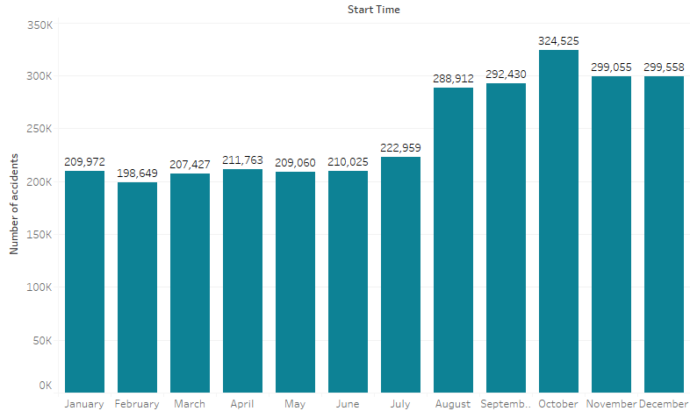
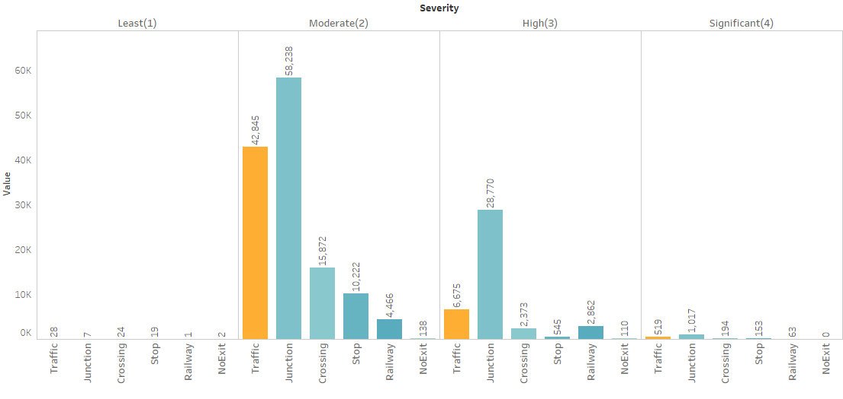
Project analysis slide 6
Appendix
7. Accidents classification in California based on Infrastructure and severity variables.
8. Accidents over months.
Notes:
Appendix

Slide 27
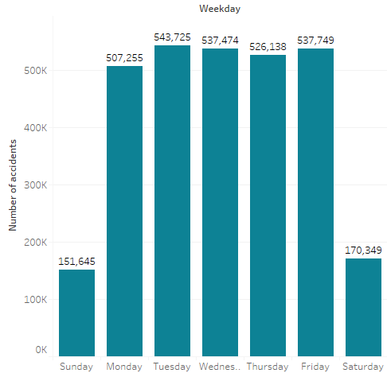
Project analysis slide 6
Appendix
9. Accidents over the days of week.
Notes:
Appendix

